Slide 1

Exploratory Data Analysis
G2M CASE STUDY
Team: Data Science
2/20/2024

Slide 2

Agenda
Executive Summary
Problem Statement
Approach
EDA
EDA Summary
Recommendations

Slide 3
Background-G2M CAB CASE STUDY
XYZ is a private equity firm in US. Due to remarkable growth in the Cab Industry in last few years and multiple key players in the market, it is planning for an investment in Cab industry.
Objective : Provide actionable insights to help XYZ firm in identifying the right company for making investment.
The analysis has been divided into four parts:
Data Understanding
Forecasting profit and number of rides for each cab type
Finding the most profitable Cab company
Recommendations for investment

Slide 4

Data Exploration
Cab data trans_data city_data cust_data
14 fields
Time frame of Data(2016-01-08) to 2018-01-04
Total number of records 359392
Assumptions:
Outliers are present in Price_Charged feature but due to
unavailability of trip duration details ,we are not treating this as outlier.
Profit of rides are calculated keeping other factors constant and only
Price_Charged and Cost_of_Trip features used to calculate profit.
Users feature of city dataset is treated as number of cab users in the city.
we have assumed that this can be other cab users as well(including Yellow and
Pink cab)
Master Data

Slide 5
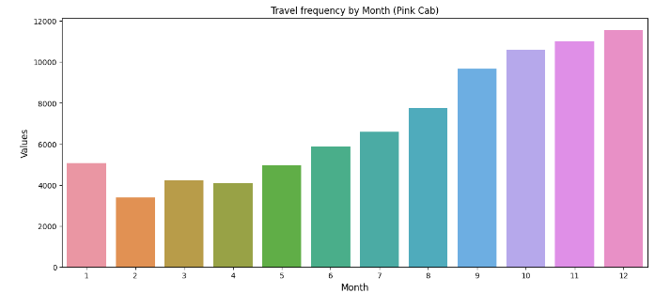
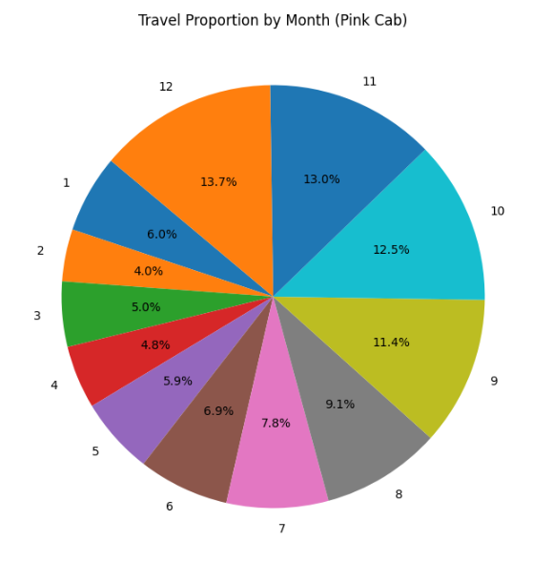
Monthly Transaction Analysis for Pink Cab
Yellow Cab has higher travels (35000) in the month of December which is the holiday season compared to Pink Cab (11000)

Slide 6

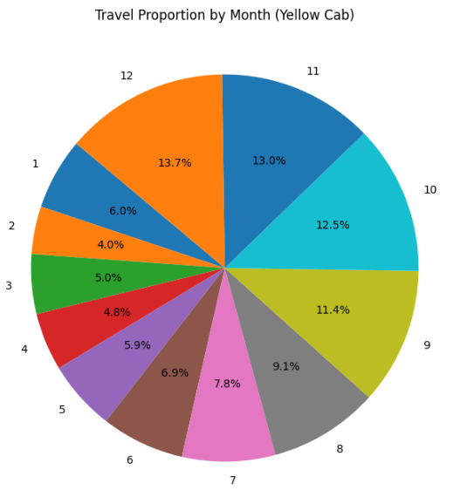
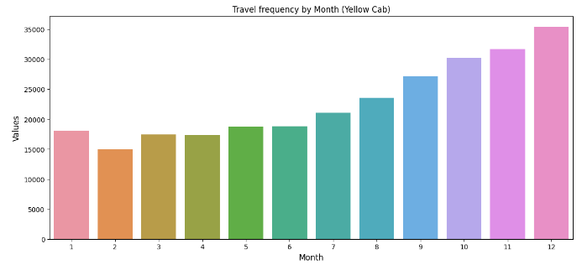
Monthly Transaction analysis for Yellow Cab
Yellow Cab has higher travels (35000) in the month of December which is the holiday season compared to Pink Cab (11000)

Slide 7
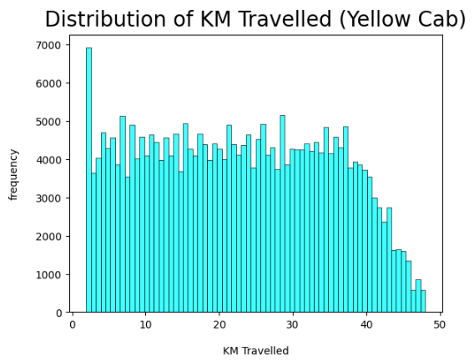
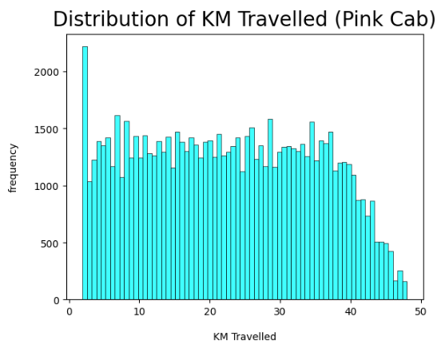
Distribution of KM travelled by Each cab
From the above graphs, we can see that for both Pink and Yellow Cab most of the rides are in the range of approximately 2 to 48 KM

Slide 8
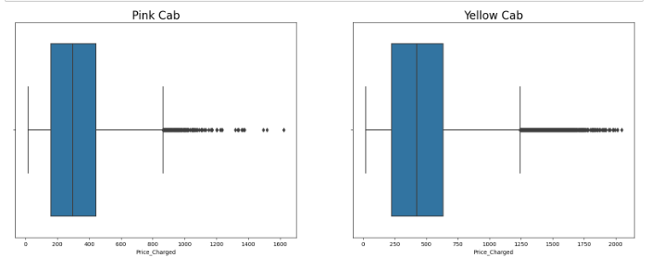
Distribution of price charged for both cabs
The Price Charge range for Yellow cab is more than the Pink cab. The outliers are due to use of high-end cars.

Slide 9
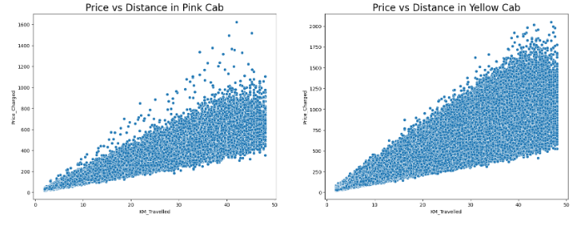
Price Vs Distance in both cabs

Slide 10
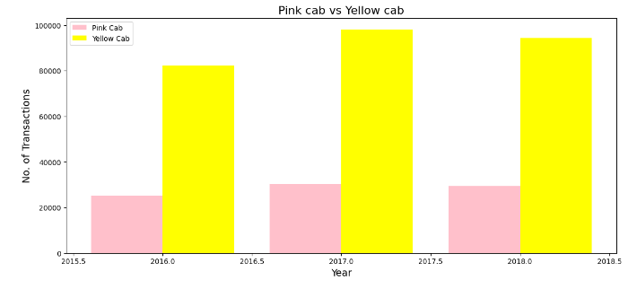
Yearly Transactions for both cabs
From the graph it shows that on yearly basis no. of transactions for Yellow cab is higher than Pink cab

Slide 11
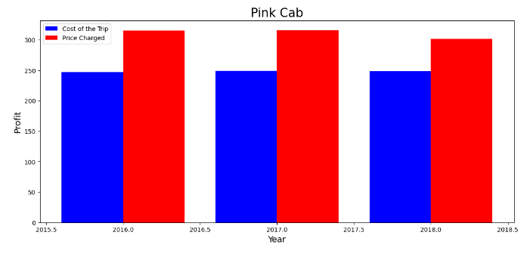
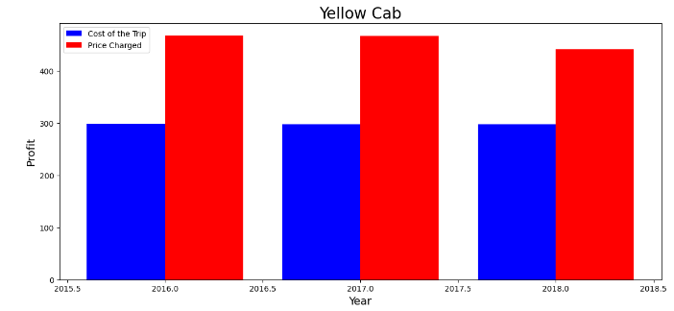
Yearly Profit (Cost of Trip-Price Charged)
We can observe that the Profit margin is higher for yellow cab compared to pink

Slide 12
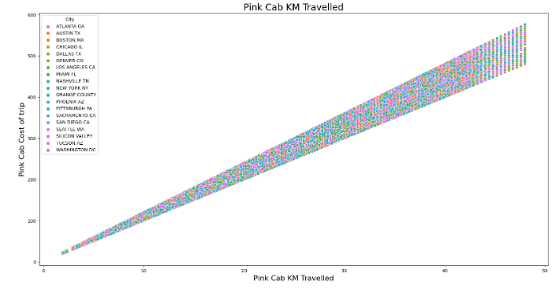
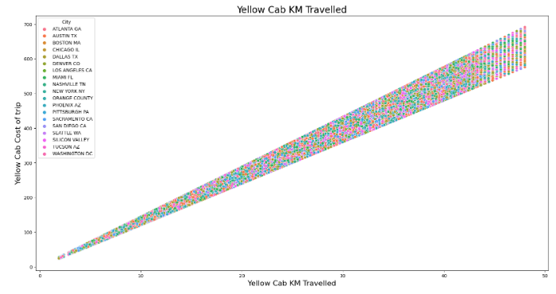
Cost of Trip Vs KM Travelled
For Pink cab all the cities have the same increase in price charge with increase in distance.
In New York City the Price charged for Yellow Cab is more in comparison to the other cities.

Slide 13
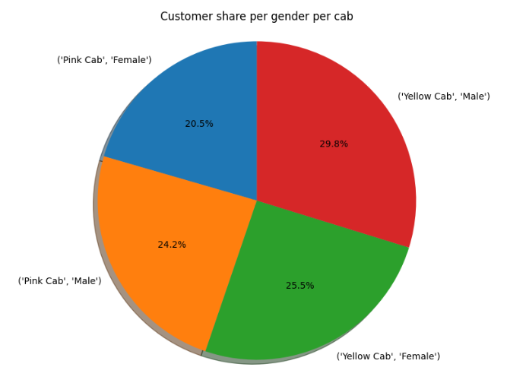
Price charged based on Gender
Female Customers in Yellow Cab is higher compared to Male customers
Female Customers in Yellow Cab(25.5%) is higher compared to Pink Cab (20.5%)

Slide 14
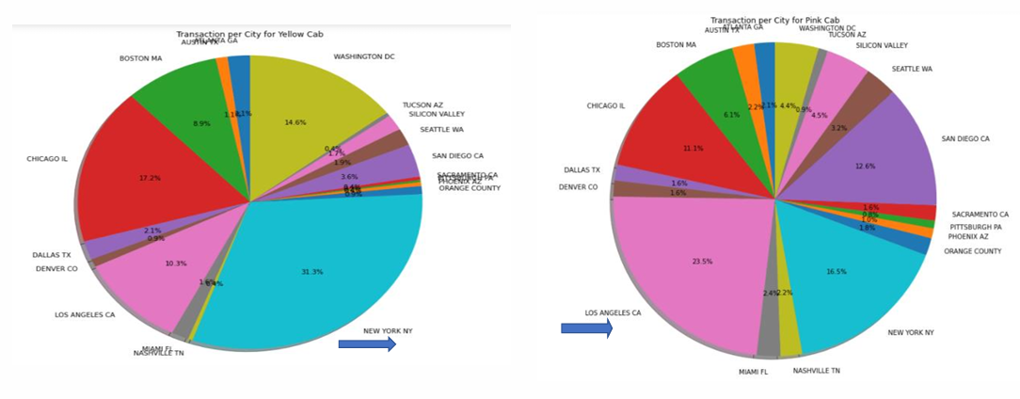
Transaction per City for both Cabs
Transaction for Yellow Cab is highest in New York City(31%) and New York City has the highest Cab Users of 28% as per the previous slide. Transaction for Pink Cab is highest in Los Angeles City.

Slide 15
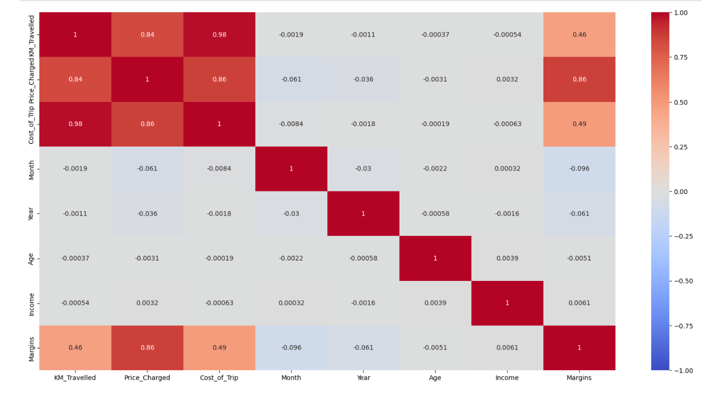
Correlation Between Margin and Price Charged

Slide 16
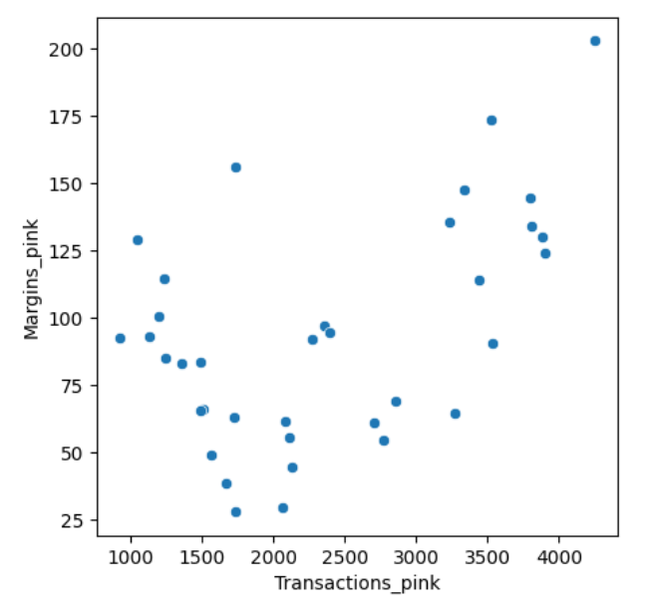
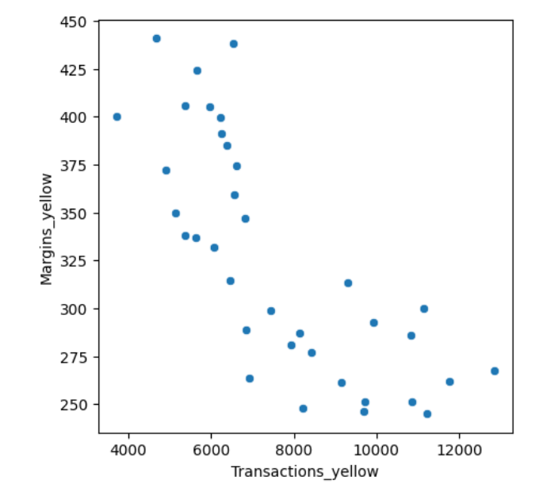
Margin Vs Transactions
Pink
Yellow

Slide 17
Comparison between Pink and Yellow cabs
Rides are in the range of approximately 2 to 48 KM.
Price Charge range from 150 to 450 dollars.
In December which is the holiday season, no. of travels was around 11000.
Transaction per year: 2016: 20000 – 40000 2017: 20000 – 40000 2018: 20000 – 40000
All the cities have the same increase in price charge with increase in distance.
Rides are in the range of approximately 2 to 48 KM.
Price Charge range from 250 to 600 dollars.
In December which is the holiday season, no. of travels was around 35000.
Transaction per year: 2016: 80000 – 100000 2017: 80000 – 100000 2018: 80000 – 100000
In New York City the Price charged for Yellow Cab is more in comparison to the other cities

Slide 18
Comparison between Pink and Yellow cabs
Pink Cab charges same for both Male and Female Customers.
Female customers are around 20.5% out of the total Customers. 
Profit Margin is low each year (2016-2018) compared to Yellow Cab.
Pink Cabs increase margins with increase in number of Transactions
Yellow Cab charge less from Female Customers.
Female customers are around 25.5% out of the total Customers.
Profit Margin is high each year (2016-2018) compared to Pink Cab.
Yellow Cab decrease Margins with the increase in Transaction

Slide 19
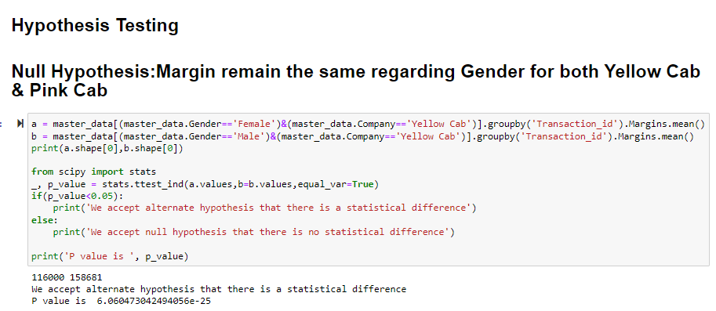

Slide 20
Observations with respect to Margin
Yellow Cab: There is difference in Margin between Male and Female customers
Pink Cab: There is no difference in Margin between Male and Female customers
Yellow Cabs also gives discount to people older than 50
There is no difference in Margin regarding mode of Payment for both Yellow & Pink Cab

Slide 21
Thank You

